Slide 1
VEGAS: A Soft Vector Processor
Aaron Severance
Some slides from Prof. Guy Lemieux and Chris Chou

Slide 2
Outline
Motivation
Vector Processing Overview
VEGAS Architecture
Example programs
Advanced Features

Slide 3
Motivation
DE1/DE2 Audio/Video processing options
  NIOS: Easy but slow
  Customize system: Fast but hard
  VEGAS: Pretty fast, pretty easy
VEGAS processor is in v4 build of UBC’s DE1 media computer
  Speed up applications yet still write C code

Slide 4
Overview of Vector Processing

Slide 5
Acceleration with Vector Processing
Organize data as long vectors
Data-level parallelism
Vector instruction execution
  Multiple vector lanes (SIMD)
  Repeated SIMD operation over length of vector
Vector lanes
for (i=0; i<NELEM; i++)
a[i] = b[i] * c[i]
vmult a, b, c
Source
vector
registers
Destination
vector
register
Notes:
Long vectors of 32 and above
Vector addressing
Efficient way to gather data
Eliminates pack/unpack instructions
Will be discussed more on the next slide

Slide 6
Advantages of Vector Processing
Simple programming model
  Short to long vector data parallelism
  Regular, easy to accelerate
Scalable performance and area
  DE1 only has room for one vector lane, but removing other components could make room for more
  Larger FPGAs can support multiple lanes
    Same exact code runs faster
Notes:
Scalable to different maximum vector lengths and numbers of parallel pipelines
Regular, makes it easy to accelerate
Shown by Berkeley VIRAM vector processor project to work better than SS and VLIW in data-parallel embedded workload
Soft vector processor abstracts FPGA resources

Slide 7
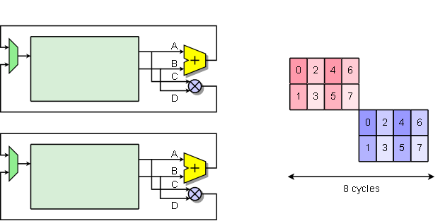
Hybrid vector-SIMD
for( i=0; i<NELEM; i++ ) {
C[i] = A[i] + B[i]
E[i] = C[i] * D[i]
}
C
E
6
4
2
0
C
E
7
5
3
1

Slide 8
VEGAS Architecture

Slide 9
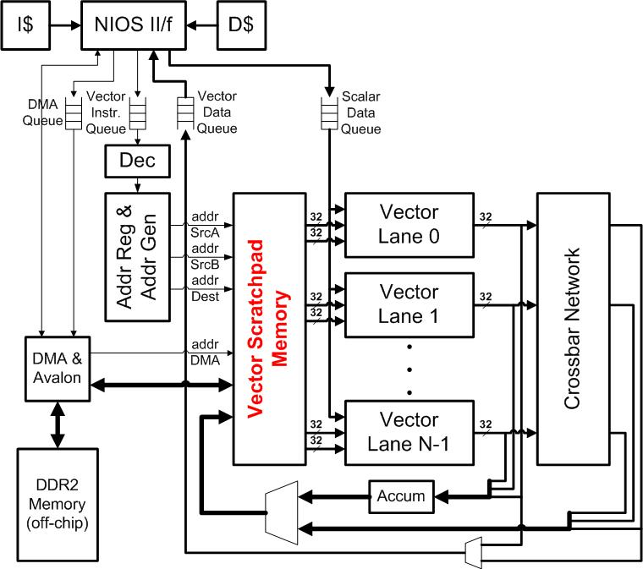
VEGAS Architecture
Scalar Core:
NiosII/f @ 200MHz
Vector Core:
VEGAS @ 120MHz
Concurrent Execution FIFO synchronized
VEGAS
DMA Engine & External DDR2

Slide 10
Key Features of VEGAS
Configurable vector processor
  Selectable performance/area tradeoff
    Working in FPGA: 1 lane … 128 lanes
    More lanes possible
  Fracturable ALUs: 1x32, 2x16, 4x8
  Scratchpad-based “register file”
    Very long vectors
    Explicitly managed memory communication
Notes:
Allows area customization according to application requirements
Will discuss customizable aspects in a later slide

Slide 11
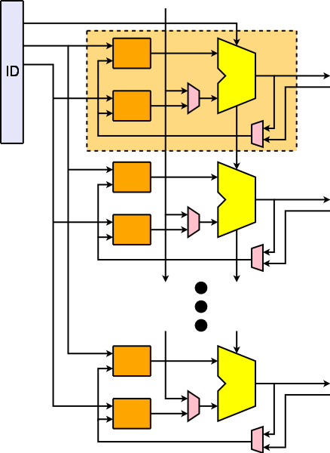
Scratchpad
Memory
4
0
+
AF
4
0
5
1
One vector
(eg, V0)
No vector length
restrictions
No address
alignment
(starting offset)
restrictions
5
1
7
3
7
3
Distributed
Vector data

Slide 12
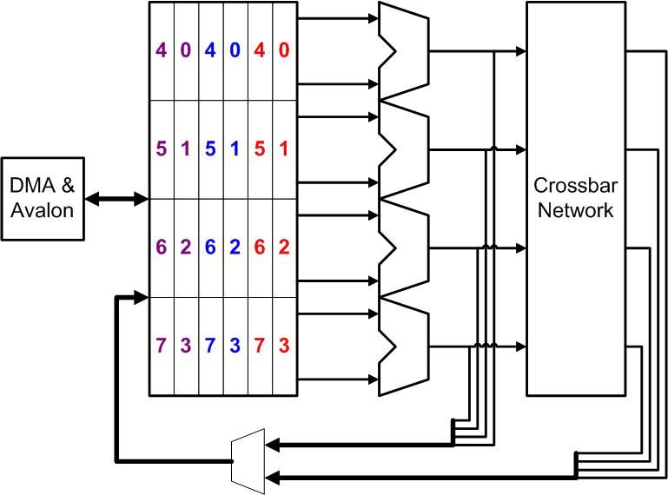
Scratchpad Memory in Action
Dest
Dest
srcB
srcB
srcA
srcA
Vector Scratchpad Memory
Vector Lane 0
Vector Lane 1
Vector Lane 2
Vector Lane 3
Notes:
Start with double pumped memory to allow exclusive port for concurrent DMA access, hides memory latency. Then do animation.

Slide 13
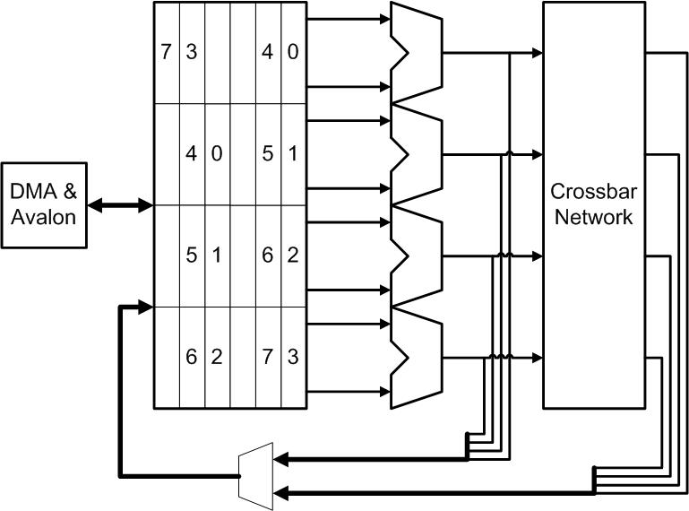
Scratchpad Memory in Action
srcA
Dest

Slide 14
Performance
Benchmark | NiosII/f | VEGAS |  | NiosII/V32 Speedup
 |  | V1 | V32
fir | 509919 | 85549 | 4693 | 108x
motest | 1668869 | 82515 | 24717 | 67x
median | 1388 | 185 | 7 | 208x
autocor | 124338 | 45027 | 2822 | 44x
conven | 48988 | 3462 | 1897 | 25x
imgblend | 1231172 | 175890 | 35485 | 34x
filt3x3 | 6556592 | 813471 | 75349 | 87x
Notes:
Build new table, only only nios, v1, v32, and v32/nios speedup

Slide 15
Example Problems

Slide 16
Overall Process
Allocate vectors in scratchpad
Move data from memory → scratchpad
Point vector address registers to data in scratchpad
Perform vector operation
Move data from scratchpad → memory
Check result using Nios

Slide 17
Example #1: Vector * Constant
int data[128] = { 0, 1, 2, 3, 4, 5, ... , 127 };
int multiplier = 3;
Allocate vectors in scratchpad
int *vector_data;
vector_data = vegas_malloc( 128*4 ); // 128 words long, in scratchpad
Move data from memory → scratchpad
vegas_dma_to_vector( vector_data, data, 128*4 );// copy from ‘data’
Point vector address registers to data in scratchpad
vegas_set( VADDR, V1, vector_data ); // can use V1 .. V7 address reg.
vegas_set( VCTRL, VL, 128 ); // # of elements
Perform vector operation
vegas_wait_for_dma(); // wait for DMA copy to finish
vegas_vsw( VMULLO, V1, V1, multiplier ); // only 1 VEGAS instruction
Move data from scratchpad → memory
vegas_instr_sync(); // wait for all VEGAS instr
vegas_dma_to_host( data, vector_out, 128*4 ); // copy results back
vegas_wait_for_dma(); // wait for DMA copy to finish

Slide 18
Example #1: Vector * Constant
int data[128] = { 0, 1, 2, 3, 4, 5, ... , 127 };
int multiplier = 3;

Slide 19
Example #1: Vector * Constant
int data[128] = { 0, 1, 2, 3, 4, 5, ... , 127 };
int multiplier = 3;
Allocate vectors in scratchpad
Move data from memory → scratchpad
Point vector address registers to data in scratchpad
Perform vector operation
Move data from scratchpad → memory

Slide 20
Example #1: Vector * Constant
int data[128] = { 0, 1, 2, 3, 4, 5, ... , 127 };
int multiplier = 3;
Allocate vectors in scratchpad
int *vector_data;
vector_data = vegas_malloc( 128*4 ); // 128 words long, in scratchpad
Move data from memory → scratchpad
Point vector address registers to data in scratchpad
Perform vector operation
Move data from scratchpad → memory

Slide 21
Example #1: Vector * Constant
int data[128] = { 0, 1, 2, 3, 4, 5, ... , 127 };
int multiplier = 3;
Allocate vectors in scratchpad
int *vector_data;
vector_data = vegas_malloc( 128*4 ); // 128 words long, in scratchpad
Move data from memory → scratchpad
vegas_dma_to_vector( vector_data, data, 128*4 );// copy from ‘data’
Point vector address registers to data in scratchpad
Perform vector operation
Move data from scratchpad → memory

Slide 22
Example #1: Vector * Constant
int data[128] = { 0, 1, 2, 3, 4, 5, ... , 127 };
int multiplier = 3;
Allocate vectors in scratchpad
int *vector_data;
vector_data = vegas_malloc( 128*4 ); // 128 words long, in scratchpad
Move data from memory → scratchpad
vegas_dma_to_vector( vector_data, data, 128*4 );// copy from ‘data’
Point vector address registers to data in scratchpad
vegas_set( VADDR, V1, vector_data ); // can use V1 .. V7 address reg.
vegas_set( VCTRL, VL, 128 ); // # of elements
Perform vector operation
Move data from scratchpad → memory

Slide 23
Example #1: Vector * Constant
int data[128] = { 0, 1, 2, 3, 4, 5, ... , 127 };
int multiplier = 3;
Allocate vectors in scratchpad
int *vector_data;
vector_data = vegas_malloc( 128*4 ); // 128 words long, in scratchpad
Move data from memory → scratchpad
vegas_dma_to_vector( vector_data, data, 128*4 );// copy from ‘data’
Point vector address registers to data in scratchpad
vegas_set( VADDR, V1, vector_data ); // can use V1 .. V7 address reg.
vegas_set( VCTRL, VL, 128 ); // # of elements
Perform vector operation
vegas_wait_for_dma(); // wait for DMA copy to finish
vegas_vsw( VMULLO, V1, V1, multiplier ); // only 1 VEGAS instruction
Move data from scratchpad → memory

Slide 24
Example #1: Vector * Constant
int data[128] = { 0, 1, 2, 3, 4, 5, ... , 127 };
int multiplier = 3;
Allocate vectors in scratchpad
int *vector_data;
vector_data = vegas_malloc( 128*4 ); // 128 words long, in scratchpad
Move data from memory → scratchpad
vegas_dma_to_vector( vector_data, data, 128*4 );// copy from ‘data’
Point vector address registers to data in scratchpad
vegas_set( VADDR, V1, vector_data ); // can use V1 .. V7 address reg.
vegas_set( VCTRL, VL, 128 ); // # of elements
Perform vector operation
vegas_wait_for_dma(); // wait for DMA copy to finish
vegas_vsw( VMULLO, V1, V1, multiplier ); // only 1 VEGAS instruction
Move data from scratchpad → memory
vegas_instr_sync(); // wait for all VEGAS instr
vegas_dma_to_host( data, vector_out, 128*4 ); // copy results back
vegas_wait_for_dma(); // wait for DMA copy to finish

Slide 25
Example: Brighten Screen
RGB packed into 16-bits (5-6-5)
for(y = 0; y < MAX_Y_PIXELS; y++){
pPixel = getPixelAddr(0,y);
for(x = 0; x < MAX_X_PIXELS; x++){
colour = *pPixel;
r = (colour >> 10) & 0x3E;
g = (colour >> 5) & 0x3F;
b = (colour << 1) & 0x3E;
r = min(r+2,62);
g = min(g+2,63);
b = min(b+2,62);
colour = (r<<10) | (g<<5) | (b>>1);
*pPixel++ = colour;
}
}

Slide 26
Designing for VEGAS
Brighten one row of pixels at a time
Move row into scratchpad
Process data
  Separate into R, G, and B vectors
  Add 2 to each
  Check for overflow
Move data back to main memory
See vegas_demo1.c in hw files on website

Slide 27
Setting up vectors/address registers
Pointers point to vectors in scratchpad
unsigned short *vR;
unsigned short *vG;
unsigned short *vB;
Malloc allocates space for the vector
vR = vegas_malloc(MAX_X_PIXELS*sizeof(unsigned short));
vG = vegas_malloc(MAX_X_PIXELS*sizeof(unsigned short));
vB = vegas_malloc(MAX_X_PIXELS*sizeof(unsigned short));
Address registers get set to pointers
vegas_set(VCTRL,VL,MAX_X_PIXELS);
vegas_set(VADDR,V1,vR);
vegas_set(VADDR,V2,vG);
vegas_set(VADDR,V3,vB);

Slide 28
Transferring data to the scratchpad
for(y = 0; y < MAX_Y_PIXELS; y++){
DMA transfer line to scratchpad
pLine = getPixelAddr(0,y);
vegas_dma_to_vector(vR, pLine, MAX_X_PIXELS*sizeof(unsigned short));
Wait until finished before processing
vegas_wait_for_dma();

Slide 29
Process data (part 1)
Data in R. Separate R,G,B
vegas_svh(VSLL,V3,1,V1); //b = line << 1;
vegas_svh(VSRL,V2,5,V1); //g = line >> 5;
vegas_svh(VSRL,V1,10,V1); //r = line >> 10;
vegas_vsh(VAND,V3,V3,0x3E); //b = b & 0x3E;
vegas_vsh(VAND,V2,V2,0x3F); //g = g & 0x3F;
vegas_vsh(VAND,V1,V1,0x3E); //r = r & 0x3E;
svh means ‘scalar-vector halfword’
  vs means ‘vector-scalar’, vv ‘vector-vector’
  h=halfword, b=byte, w=word
VSLL/VSRL are opcodes
  Some have an unsigned variant ending in U
Destination, Source A, Source B

Slide 30
Process data (part 2)
Add two and check for overflow
vegas_vsh(VADD,V3,V3,2); //b = b + 2;
vegas_vsh(VADD,V2,V2,2); //g = g + 2;
vegas_vsh(VADD,V1,V1,2); //r = r + 2;
vegas_vsh(VMIN,V3,V3,62); //b = min(b,62);
vegas_vsh(VMIN,V2,V2,63); //g = min(g,63);
vegas_vsh(VMIN,V1,V1,62); //r = min(r,62);
Merge back into packed RGB form
vegas_svh(VSRL,V3,1,V3); //b = b >> 1
vegas_svh(VSLL,V2,5,V2); //g = g << 5
vegas_svh(VSLL,V1,10,V1); //r = r << 10
vegas_vvh(VOR,V3,V3,V2); //b = b | g
vegas_vvh(VOR,V3,V3,V1); //b = b | r

Slide 31
Transfer back to main memory
Wait for vector core to finish
vegas_instr_sync();
Merge back into packed RGB form
vegas_dma_to_host(pLine, vB, MAX_X_PIXELS*sizeof(unsigned short));
Don’t have to wait_for_dma() until you read data

Slide 32
Advanced: Double buffering
Example starts DMA, immediately waits
  But vector core and DMA can be concurrent
Use two buffers
  Transfer to one while processing the other
  Switch buffers when done
See vegas_demo2.c for an example

Slide 33
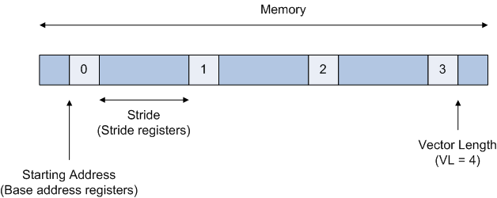
More advanced Features
Source
registers
Data-dependent conditional execution
  Vector flag registers
Vector addressing modes
  Unit stride
  Type conversion
  Constant stride
Destination
register
Flag
register
Vector Merge Operation

Slide 34
Example: Simple 5x5 Median Filtering
Output pixel
Output pixel
Pseudocode (Bubble sort)
Load the 25 pixel vectors P[0..24]
For i=0 to 12 {
minimum = P[i]
For j=i+1 to 24 {
if (P[j] < minimum) {
  swap (minimum, P[j])
  }
  }
}
Slide “window” after 1 median
  Each window 5x5 values
  Each value = CPU register
Repeated over entire image
  1st Window = Vector[0]
  2nd Window = Vector[1]
  VL = # of windows
Notes:
Minimum is a vector
Base address and stride registers

Slide 35
Example: Simple 5x5 Median Filtering
25 rows ->
25 vector registers
“VL” pixels each
Bubble sort on vector registers
Vmin,Vmax to do swap
“VL” results at once!

